Slide 1
CCNA Project Presentation
TOPIC: OSPF Mix Task
Submitted By:-
Mohit Yadav
Pulkit Chawla
Manan Aggarwal
Harshita Khandelwal
Surya Saini
Dhanuj Kumar Sharma
Srishti Jain
To:-
Mr. Vishnu Sir

Slide 2
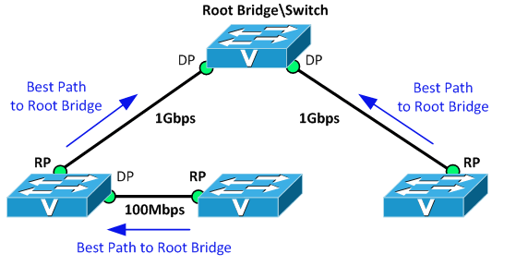

Spanning Tree Protocol (STP)

Slide 3
Spanning Tree Protocol (STP) was developed to prevent the broadcast storms caused by switching loops. STP was originally defined in IEEE 802.1D.
Switches running STP will build a map or topology of the entire switching network. STP will identify if there are any loops, and then disable or block as many ports as necessary to eliminate all loops in the topology.
A blocked port can be reactivated if another port goes down. This allows STP to maintain redundancy and fault-tolerance.
However, because ports are blocked to eliminate loops, STP does not support load balancing unless an EtherChannel is used.
STP switches exchange Bridge Protocol Data Units (BPDU’s) to build the topology database. BPDU’s are forwarded out all ports every two seconds, to a dedicated MAC multicast address of 0180.c200.0000.

Slide 4
Building the STP topology is a multistep convergence process: • A Root Bridge is elected • Root ports are identified • Designated ports are identified • Ports are placed in a blocking state as required, to eliminate loops
The Root Bridge serves as the central reference point for the STP topology. STP was originally developed when Layer-2 bridges were still prevalent, and thus the term Root Bridge is still used for nostalgic reasons. It is also acceptable to use the term Root Switch, though this is less common.
Once the full topology is determined, and loops are eliminated, the switches are considered converged.
STP is enabled by default on all Cisco switches, for all VLANs.

Slide 5
STP STATES
The ports on a switch with enabled Spanning Tree Protocol (STP) are in one of the following five port states.
• Blocking
• Listening
• Learning
• Forwarding
• Disabled
A switch does not enter any of these port states immediately except the blocking state. When the Spanning Tree Protocol (STP) is enabled, every switch in the network starts in the blocking state and later changes to the listening and learning states.

Slide 6
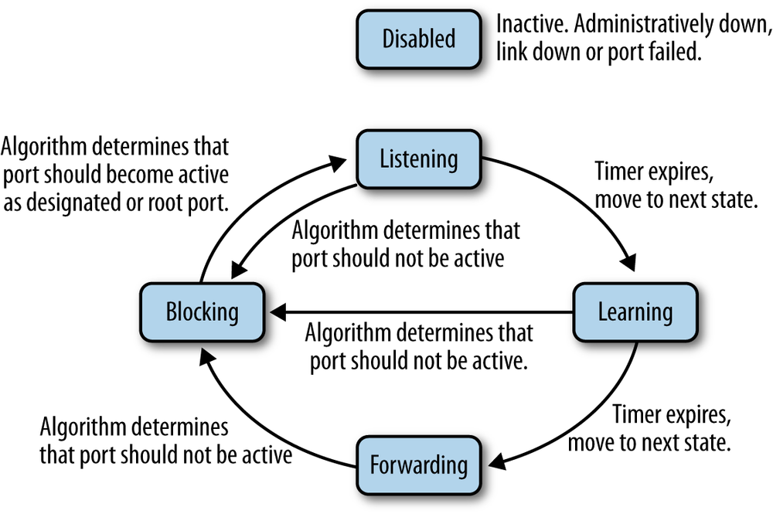

Slide 7
Blocking State
The Switch Ports will go into a blocking state at the time of election process, when a switch receives a BPDU on a port that indicates a better path to the Root Switch (Root Bridge), and if a port is not a Root Port or a Designated Port.
A port in the blocking state does not participate in frame forwarding and also discards frames received from the attached network segment. During blocking state, the port is only listening to and processing BPDUs on its interfaces. After 20 seconds, the switch port changes from the blocking state to the listening state.

Slide 8
Listening State
After blocking state, a Root Port or a Designated Port will move to a listening state. All other ports will remain in a blocked state. During the listening state the port discards frames received from the attached network segment and it also discards frames switched from another port for forwarding.
At this state, the port receives BPDUs from the network segment and directs them to the switch system module for processing. After 15 seconds, the switch port moves from the listening state to the learning state.

Slide 9
Learning State
A port changes to learning state after listening state. During the learning state, the port is listening for and processing BPDUs .
In the listening state, the port begins to process user frames and start updating the MAC address table. But the user frames are not forwarded to the destination.
After 15 seconds, the switch port moves from the learning state to the forwarding state.

Slide 10
Forwarding State
A port in the forwarding state forwards frames across the attached network segment.
In a forwarding state, the port will process BPDUs , update its MAC Address table with frames that it receives, and forward user traffic through the port. Forwarding State is the normal state.
Data and configuration messages are passed through the port, when it is in forwarding state.

Slide 11
Disabled State
A port in the disabled state does not participate in frame forwarding or the operation of STP.
Because a port in the disabled state is considered non-operational.

Slide 12
Routing Protocols
Cisco has created its own routing protocol – EIGRP. EIGRP is considered to be an advanced distance vector protocol, although some materials erroneously state that EIGRP is a hybrid routing protocol, a combination of distance vector and link state.
Types of Routing Protocols:-
DVRP
LSRP

Slide 13
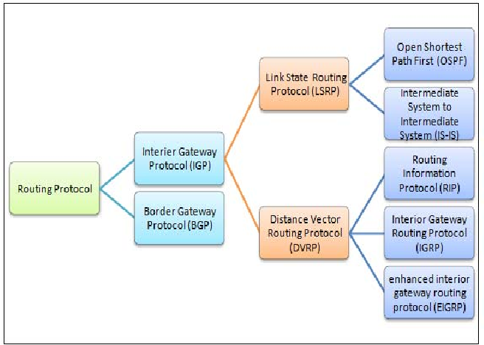

Slide 14
Distance Vector Routing Protocol (DVRP)
As the name implies, distance vector routing protocols use distance to determine the best path to a remote network. The distance is usually the number of hops (routers) to the destination network.
Distance vector protocols send complete routing table to each neighbor (a neighbor is directly connected router that runs the same routing protocol).
They usually use some version of Bellman-Ford algorithm to calculate the best routes. Compared with link state routing protocols, distance vector protocols are simpler to configure and require little management, but are susceptible to routing loops and converge slower than link state routing protocols.

Slide 15
Distance vector protocols also use more bandwidth because they send complete routing table, while link state protocols sends specific updates only when topology changes occur.
RIP and EIGRP are examples of distance vector routing protocols.

Slide 16
Link State Routing Protocol (LSRP)
Link state routing protocols are the second type of routing protocols. They have the same basic purpose as distance vector protocols, to find a best path to a destination, but use different methods to do so.
Unlike distance vector protocols, link state protocols don’t advertise the entire routing table. Instead, they advertise information about a network topology (directly connected links, neighboring routers…), so that in the end all routers running a link state protocol have the same topology database.
Link state routing protocols converge much faster than distance vector routing protocols, support classless routing, send updates using multicast addresses and use triggered routing updates.

Slide 17
Each router running a link state routing protocol creates three different tables:-
1. Neighbor table – the table of neighboring routers running the same link state routing protocol. 2. Topology table – the table that stores the topology of the entire network. 3. Routing table – the table that stores the best routes.
Shortest Path First algorithm is used to calculate the best route. OSPF and IS-IS are examples of link state routing protocols.

Slide 18
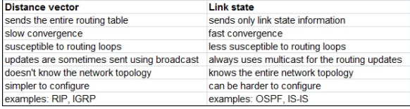
Difference between DVRP & LSRP
The following table summarizes the difference:-

Slide 19
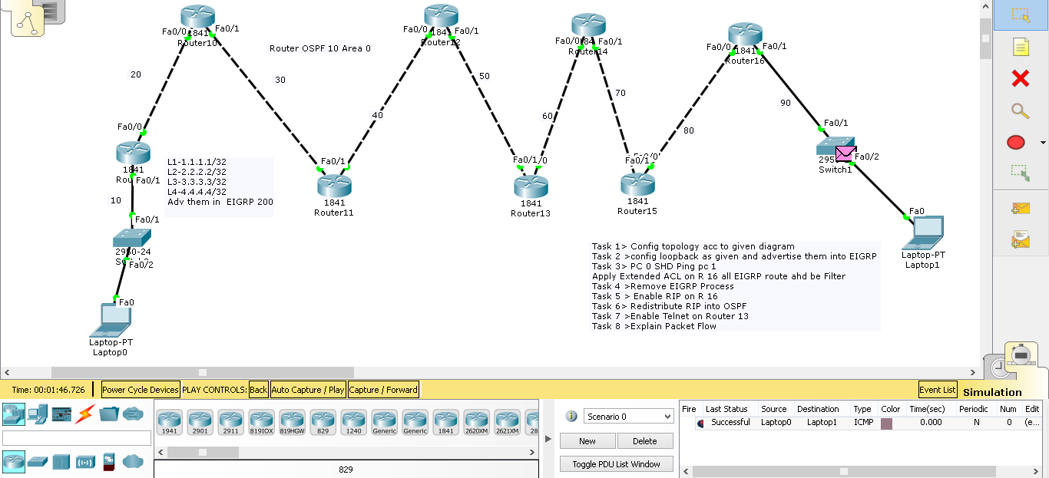
OSPF Task

Slide 20
THANK YOU

